Slide 1

Ray Tracing In
Functional Programming
Pedro Figueirêdo
ELTE Faculty of Informatics
October 25, 2019

Slide 2
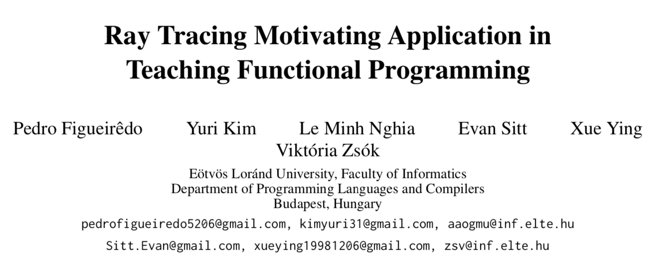
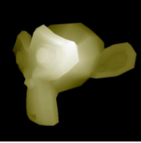


Applications

Slide 3
Records In Our Project
Vector2
Vector3
Matrix3
Ray
Triangle
IntersectionRecord
ONB
PinholeCamera

Slide 4
Abstract Data Types In Our Project
Vector2
Vector3
Matrix3
Triangle
ONB
PinHoleCamera

Slide 5
Let’s look at the code!

